Slide 1



AcF 304 Financial Markets Topic 5 – The Foreign Exchange Market
Part 2 – FX in the Long Run – The Theory
Notes:
If this PowerPoint presentation contains mathematical equations, you may need to check that your computer has the following installed:
1) MathType Plugin
2) Math Player (free versions available)
3) NVDA Reader (free versions available)

Slide 2
Exchange Rates in the Long Run
Exchange rates are determined in markets by the interaction of supply and demand.
An important concept that drives the forces of supply and demand is the Law of One Price.

Slide 3
Exchange Rates in the Long Run: Law of One Price (1 of 2)
The Law of One Price states that the price of an identical good will be the same throughout the world, regardless of which country produces it.
Example: American steel costs $100 per ton, while Japanese steel costs 10,000 yen per ton.
For the Law of One Price to hold, the exchange rate between the Yen and the Dollar must be 100 yen per dollar, so that one ton of American steel sells for 10,000 Yen in Japan (the price of Japanese steel) and one ton of Japanese steel sells for $100 in the US (the price of US steel) in the Unites States.

Slide 4
Exchange Rates in the Long Run: Law of One Price (2 of 2)
If the exchange rate were 200 Yen to the Dollar, Japanese steel would sell for $50 in the US or half the price of American steel, and American steel would sell for Yen 20,000 in Japan, twice the price of Japanese steel.
Because American steel is identical to Japanese steel but would be more expensive in both countries, the demand for American steel would be zero.
Given the fixed dollar price for American steel, the resulting excess supply of American steel would only be eliminated if the exchange rate falls to 100 yen per dollar, making the price of American steel and Japanese steel the same in both countries.

Slide 5
Exchange Rates in the Long Run: Theory of Purchasing Power Parity (PPP) (1 of 2)
The theory of PPP states that exchange rates between two currencies will adjust to reflect changes in price levels.
PPP ⇒ Domestic price level ↑ 10%, domestic currency ↓ 10%
10% rise in price of Japanese Steel =10% fall in Yen versus USD
Application of law of one price to price levels
Works in long run, not short run

Slide 6
Exchange Rates in the Long Run: Theory of Purchasing Power Parity (PPP) (2 of 2)
Problems with PPP
All goods are not identical in both countries (e.g., Toyota versus Chevy)
Many goods and services are not traded (e.g., haircuts, land, etc.)
Assumes trade barriers are low

Slide 7
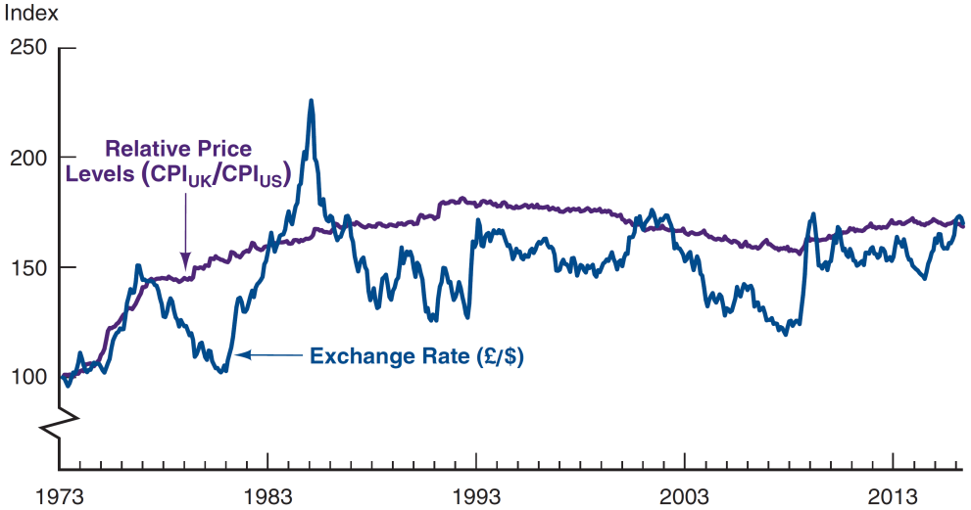
Figure 15.2 Purchasing Power Parity, United States/United Kingdom, 1973–2016 (Index: March 1973 = 100)
Source: Federal Reserve Bank of St. Louis FRED database: https://fred.stlouisfed.org/series/CP0000GBM086NEST; https://fred.stlouisfed.org/series/CPIAUCNS; https://fred.stlouisfed.org/series/EXUSUK.
Over the whole period, the rise in the British price level relative to the US price level is associated with a rise in the value of the dollar/fall in British Pound, as PPP predicts. However, the PPP relationship does not hold for shorter periods.

Slide 8
Trade Barriers Affect on Exchange Rates
US increases the tariffs (taxes on imported goods) on French wine.
So French wine becomes more expensive in US .
The increase in tariffs increases demand for US wine domestically.
The USD tends to appreciate in the long run because American wine will still sell well despite a higher value of the dollar.

Slide 9





Trade Barriers - Trump

Slide 10
AcF 304 Financial Markets Topic 5
Part 3 - FX in the Short Run – The Practise
Notes:
If this PowerPoint presentation contains mathematical equations, you may need to check that your computer has the following installed:
1) MathType Plugin
2) Math Player (free versions available)
3) NVDA Reader (free versions available)

